Slide 1




BRAND
GUIDELINES
October 2026 / Version 1.4
Notes:
Structure and page topic adapted from West Valley College Brand Guidelines, page 1: https://www.westvalley.edu/offices/marketing/_files/pdf/wvc-brand-guidelines.pdf. Maximizing Potential visual identity: current BRAND.md and existing logo kit. Original MP wording; strategy pages 4–7 are proposed. Reusable source artwork is in the supplied asset pack. Stock photo: Andy Barbour / Pexels. https://www.pexels.com/photo/group-of-students-working-together-6684552/ License: https://www.pexels.com/license/. Illustrative stock, not a Maximizing Potential event.
Stock photo: RDNE Stock project / Pexels. https://www.pexels.com/photo/volunteers-cleaning-the-street-6647012/ License: https://www.pexels.com/license/. Illustrative stock, not a Maximizing Potential event.
Stock photo: Mikhail Nilov / Pexels. https://www.pexels.com/photo/people-working-in-a-workshop-9242850/ License: https://www.pexels.com/license/. Illustrative stock, not a Maximizing Potential event.

Slide 2

A clear identity.
A shared purpose.
Our brand helps people recognize Maximizing Potential and understand the work we are building. Every message, image and interaction should make that work clearer and more trustworthy.
Use this guide
to make every
communication
feel connected.
MAXIMIZING POTENTIAL / BRAND GUIDELINES
02
Notes:
Structure and page topic adapted from West Valley College Brand Guidelines, page 2: https://www.westvalley.edu/offices/marketing/_files/pdf/wvc-brand-guidelines.pdf. Maximizing Potential visual identity: current BRAND.md and existing logo kit. Original MP wording; strategy pages 4–7 are proposed. Reusable source artwork is in the supplied asset pack. Stock photo: Keira Burton / Pexels. https://www.pexels.com/photo/diverse-young-students-discussing-education-at-table-with-laptop-6147045/ License: https://www.pexels.com/license/. Illustrative stock, not a Maximizing Potential event.

Slide 3



Contents
One identity, across every point of contact.
01
Brand Strategy
4
06
Photography
22
02
Logo
8
07
Accessibility
24
03
Color Palette
14
08
Content Guidelines
26
04
Typography
17
09
Applications
28
05
Graphic Elements
19
Help & resources · 32
MAXIMIZING POTENTIAL / BRAND GUIDELINES
03
Notes:
Structure and page topic adapted from West Valley College Brand Guidelines, page 3: https://www.westvalley.edu/offices/marketing/_files/pdf/wvc-brand-guidelines.pdf. Maximizing Potential visual identity: current BRAND.md and existing logo kit. Original MP wording; strategy pages 4–7 are proposed. Reusable source artwork is in the supplied asset pack. Stock photo: Moe Magners / Pexels. https://www.pexels.com/photo/a-man-explaining-in-front-of-the-whiteboard-7495556/ License: https://www.pexels.com/license/. Illustrative stock, not a Maximizing Potential event.
Stock photo: Mikhail Nilov / Pexels. https://www.pexels.com/photo/a-person-holding-a-soldering-iron-9242903/ License: https://www.pexels.com/license/. Illustrative stock, not a Maximizing Potential event.
Stock photo: Gustavo Fring / Pexels. https://www.pexels.com/photo/happy-group-of-volunteers-7156175/ License: https://www.pexels.com/license/. Illustrative stock, not a Maximizing Potential event.

Slide 4
Brand Guidelines
Brand Strategy
Our brand explains who we aim to support, the practical help we are developing and what people can rely on us to communicate.
Mission, vision & values
Positioning, promise & personality
Brand pyramid
01
Proposed strategy
For leadership review
MAXIMIZING POTENTIAL / BRAND GUIDELINES
04
Notes:
Structure and page topic adapted from West Valley College Brand Guidelines, page 4: https://www.westvalley.edu/offices/marketing/_files/pdf/wvc-brand-guidelines.pdf. Maximizing Potential visual identity: current BRAND.md and existing logo kit. Original MP wording; strategy pages 4–7 are proposed. Reusable source artwork is in the supplied asset pack.

Slide 5
Mission, Vision & Values
Proposed statements aligned with our current public direction.
Mission
Community purpose
Start with the people affected and the need they identify.
Fund independent founders, mission-led organizations and projects that serve communities.
Practical support
Connect an idea to a clear, achievable next step.
Respect
Treat participants and collaborators as people with agency.
Vision
Accountability
A future in which people with useful ideas for their communities can find the early support to put them into practice.
Explain decisions and results with evidence.
Learning
Test carefully, listen and improve the work.
PROPOSED STRATEGY · FOR LEADERSHIP REVIEW
MAXIMIZING POTENTIAL / BRAND GUIDELINES
05
Notes:
Structure and page topic adapted from West Valley College Brand Guidelines, page 5: https://www.westvalley.edu/offices/marketing/_files/pdf/wvc-brand-guidelines.pdf. Maximizing Potential visual identity: current BRAND.md and existing logo kit. Original MP wording; strategy pages 4–7 are proposed. Reusable source artwork is in the supplied asset pack.

Slide 6

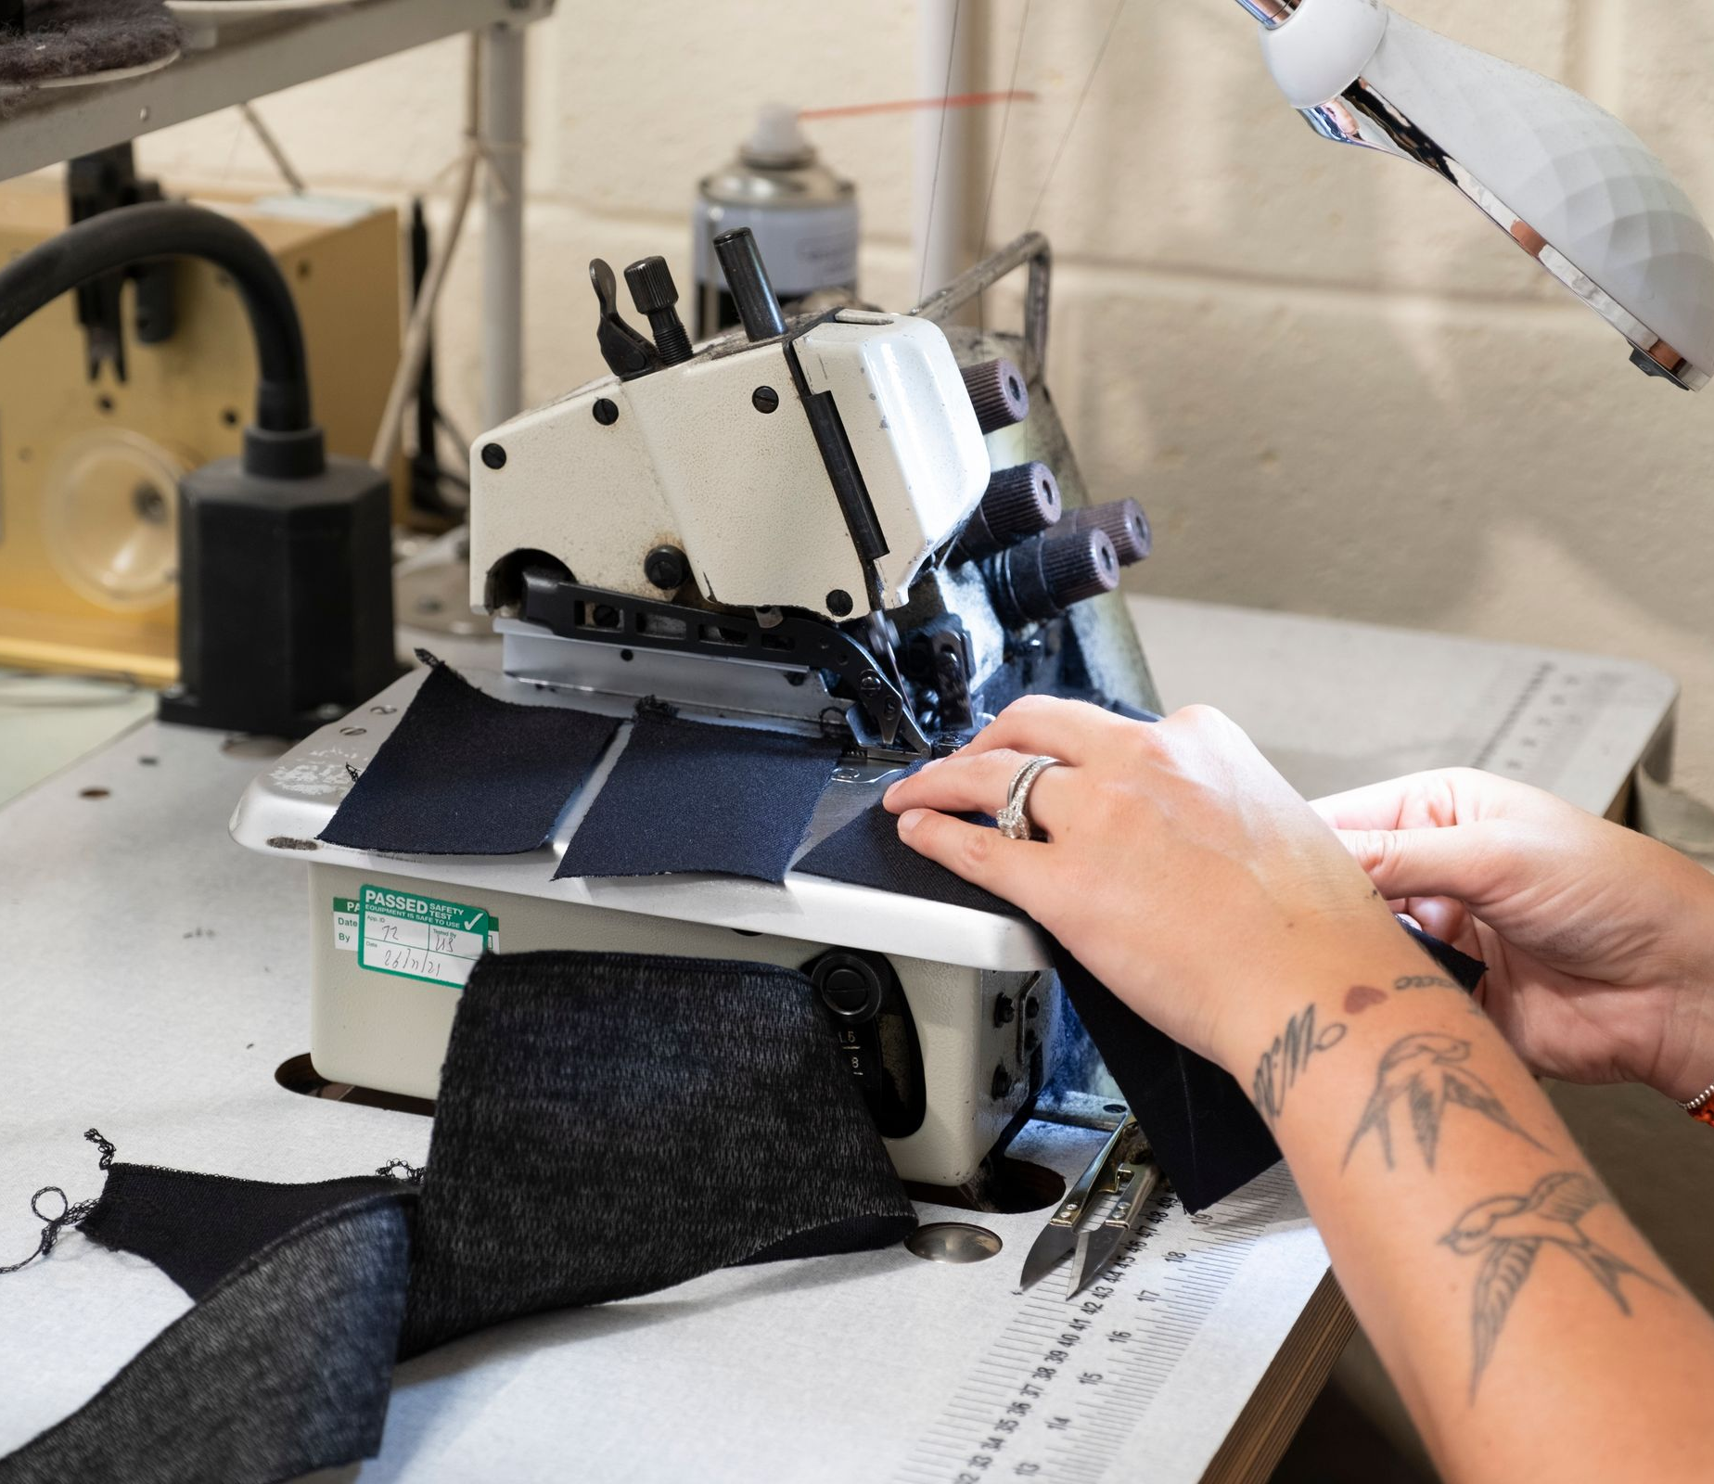
Positioning, Promise & Personality
Positioning
Maximizing Potential is an emerging source of early support for independent founders, mission-led organizations and social-good projects. Our direction combines funding with practical guidance so people can test an idea and take a useful next step.
Promise
Make the purpose, support and next step clear—and be honest about what is available, what is planned and what has been achieved.
Personality
Encouraging · Practical · Clear
Respectful · Curious · Accountable
PROPOSED STRATEGY · FOR LEADERSHIP REVIEW
MAXIMIZING POTENTIAL / BRAND GUIDELINES
06
Notes:
Structure and page topic adapted from West Valley College Brand Guidelines, page 6: https://www.westvalley.edu/offices/marketing/_files/pdf/wvc-brand-guidelines.pdf. Maximizing Potential visual identity: current BRAND.md and existing logo kit. Original MP wording; strategy pages 4–7 are proposed. Reusable source artwork is in the supplied asset pack. Stock photo: Vanessa Garcia / Pexels. https://www.pexels.com/photo/photo-of-professor-mentoring-his-student-6325975/ License: https://www.pexels.com/license/. Illustrative stock, not a Maximizing Potential event.
Stock photo: Mick Latter / Pexels. https://www.pexels.com/photo/a-person-using-sewing-machine-12983499/ License: https://www.pexels.com/license/. Illustrative stock, not a Maximizing Potential event.

Slide 7
Brand Pyramid
A proposed hierarchy for consistent decisions and communication.
ORGANIZATION
Maximizing Potential
PROMISE
Clear purpose. Practical next steps. Honest reporting.
POSITIONING
Early support for people and projects serving communities.
EMOTIONAL BENEFITS
Encouragement, respect, confidence and shared purpose.
FUNCTIONAL BENEFITS
Funding, practical guidance, clear criteria and useful reporting.
REASONS TO BELIEVE
Named leadership, published organization details, visible program boundaries.
PERSONALITY
Encouraging · Practical · Clear · Respectful · Curious · Accountable
Intended benefits describe programs in development; they are not a statement of current availability.
PROPOSED STRATEGY · FOR LEADERSHIP REVIEW
MAXIMIZING POTENTIAL / BRAND GUIDELINES
07
Notes:
Structure and page topic adapted from West Valley College Brand Guidelines, page 7: https://www.westvalley.edu/offices/marketing/_files/pdf/wvc-brand-guidelines.pdf. Maximizing Potential visual identity: current BRAND.md and existing logo kit. Original MP wording; strategy pages 4–7 are proposed. Reusable source artwork is in the supplied asset pack.

Slide 8
Brand Guidelines
Brand Logo
Our mountain emblem and wordmark are the most immediate signs of Maximizing Potential. Use the supplied artwork consistently across every size and format.
Primary logo
Light and dark logo options
Logo variations
Usage guide
02
MAXIMIZING POTENTIAL / BRAND GUIDELINES
08
Notes:
Structure and page topic adapted from West Valley College Brand Guidelines, page 8: https://www.westvalley.edu/offices/marketing/_files/pdf/wvc-brand-guidelines.pdf. Maximizing Potential visual identity: current BRAND.md and existing logo kit. Original MP wording; strategy pages 4–7 are proposed. Reusable source artwork is in the supplied asset pack.

Slide 9





Our Logo
A navy hexagon, a white mountain-shaped M and a gold upward chevron form the core emblem. Use the supplied files to preserve its geometry and gradients.
Primary
Reversed
Clear space
Keep surrounding copy, images and page edges outside the clear-space area. Use the supplied PNG artwork at its intended size. Avoid enlarging a small image for print.
X = ¼ emblem width
Use as the minimum
starting space.
X
MAXIMIZING POTENTIAL / BRAND GUIDELINES
09
Notes:
Structure and page topic adapted from West Valley College Brand Guidelines, page 9: https://www.westvalley.edu/offices/marketing/_files/pdf/wvc-brand-guidelines.pdf. Maximizing Potential visual identity: current BRAND.md and existing logo kit. Original MP wording; strategy pages 4–7 are proposed. Reusable source artwork is in the supplied asset pack.

Slide 10



Light & Dark Logo Options
Choose the version for your background
Use navy wording on a light background and white wording on navy. Keep the complete logo proportional and preserve the original emblem colors and geometry.
Horizontal · formal communications
Stacked · events and social graphics
Use the supplied artwork without adding a supporting phrase. Keep enough contrast and clear space around the full identity.
MAXIMIZING POTENTIAL / BRAND GUIDELINES
10
Notes:
Structure and page topic adapted from West Valley College Brand Guidelines, page 10: https://www.westvalley.edu/offices/marketing/_files/pdf/wvc-brand-guidelines.pdf. Maximizing Potential visual identity: current BRAND.md and existing logo kit. Original MP wording; strategy pages 4–7 are proposed. Reusable source artwork is in the supplied asset pack.

Slide 11


Logo Variations
Choose the arrangement that fits the space. Keep the complete identity proportional and use the supplied files for horizontal, stacked, wordmark and icon formats.
Program extensions
Use the organization logo with a divider and a clearly identified program name. The template is a layout for future use; it does not establish a new program.
Replace [Program name] only after the name and relationship are confirmed. Avoid separate, unrelated program logos.
Editable program lockup template
MAXIMIZING POTENTIAL / BRAND GUIDELINES
11
Notes:
Structure and page topic adapted from West Valley College Brand Guidelines, page 11: https://www.westvalley.edu/offices/marketing/_files/pdf/wvc-brand-guidelines.pdf. Maximizing Potential visual identity: current BRAND.md and existing logo kit. Original MP wording; strategy pages 4–7 are proposed. Reusable source artwork is in the supplied asset pack.

Slide 12

Logo Variations Continued
Both words can be navy or white. The emblem keeps its established colors and geometry. The inverted emblem is a separate supplied option.
Navy wording on light
White wording on navy
Inverted emblem
Partner and special identities
Keep partner marks separate. Confirm permission, relative size and each organization’s role before use.
MAXIMIZING POTENTIAL / BRAND GUIDELINES
12
Notes:
Structure and page topic adapted from West Valley College Brand Guidelines, page 12: https://www.westvalley.edu/offices/marketing/_files/pdf/wvc-brand-guidelines.pdf. Maximizing Potential visual identity: current BRAND.md and existing logo kit. Original MP wording; strategy pages 4–7 are proposed. Reusable source artwork is in the supplied asset pack.

Slide 13
Logo Usage Guide
Preserve the artwork, its spacing and its contrast. The examples below are deliberately incorrect. The supplied emblem gradients are part of the original design.
×
×
×
Do not stretch
Do not rotate
Do not recolor
×
×
×
Do not add effects
Avoid poor contrast
Do not rearrange
MAXIMIZING POTENTIAL / BRAND GUIDELINES
13
Notes:
Structure and page topic adapted from West Valley College Brand Guidelines, page 13: https://www.westvalley.edu/offices/marketing/_files/pdf/wvc-brand-guidelines.pdf. Maximizing Potential visual identity: current BRAND.md and existing logo kit. Original MP wording; strategy pages 4–7 are proposed. Reusable source artwork is in the supplied asset pack.

Slide 14
Brand Guidelines
Color Palette
Navy provides a stable foundation. White and warm ivory give the work room to breathe. Gold adds emphasis where it helps people find the next piece of information.
Primary colors
Supporting colors
03
MAXIMIZING POTENTIAL / BRAND GUIDELINES
14
Notes:
Structure and page topic adapted from West Valley College Brand Guidelines, page 14: https://www.westvalley.edu/offices/marketing/_files/pdf/wvc-brand-guidelines.pdf. Maximizing Potential visual identity: current BRAND.md and existing logo kit. Original MP wording; strategy pages 4–7 are proposed. Reusable source artwork is in the supplied asset pack.

Slide 15
Primary Colors
Build most layouts from these three colors. Navy anchors the system; white and warm ivory create clear, generous surfaces.
NAVY
#08182C
RGB 8 · 24 · 44
Navy
Use for main text, structural elements and dark sections. It gives white, antique gold and chevron gold details strong contrast.
White & warm ivory
Use white for a clean reading surface and warm ivory when a softer background supports the content.
WHITE
#FFFFFF
RGB 255 · 255 · 255
WARM IVORY
#F7F3EA
RGB 247 · 243 · 234
Screen values are shown. No Pantone match is approved; request a color-managed print proof for the actual material.
MAXIMIZING POTENTIAL / BRAND GUIDELINES
15
Notes:
Structure and page topic adapted from West Valley College Brand Guidelines, page 15: https://www.westvalley.edu/offices/marketing/_files/pdf/wvc-brand-guidelines.pdf. Maximizing Potential visual identity: current BRAND.md and existing logo kit. Original MP wording; strategy pages 4–7 are proposed. Reusable source artwork is in the supplied asset pack.

Slide 16
Supporting Colors
Use gold sparingly to guide attention. Choose the shade for its role and contrast, rather than using one gold for every purpose.
ANTIQUE GOLD
#B08A3C
RGB 176 · 138 · 60
CHEVRON GOLD
#E7B751
RGB 231 · 183 · 81
Three golds, distinct roles
Antique gold: accent rules and fills.
Chevron gold: emphasis on navy.
Deep gold: small accent text on light surfaces.
DEEP GOLD
#7B5A1A
RGB 123 · 90 · 26
MUTED TEXT
#526173
RGB 82 · 97 · 115
The quieter neutrals support text, dividers and surfaces. They are utility colors, not alternate logo colors.
LIGHT RULE
#D8DDE1
RGB 216 · 221 · 225
PALE SURFACE
#EDEFF0
RGB 237 · 239 · 240
Antique gold on ivory fails text contrast. Use deep gold for small accent text on light backgrounds.
MAXIMIZING POTENTIAL / BRAND GUIDELINES
16
Notes:
Structure and page topic adapted from West Valley College Brand Guidelines, page 16: https://www.westvalley.edu/offices/marketing/_files/pdf/wvc-brand-guidelines.pdf. Maximizing Potential visual identity: current BRAND.md and existing logo kit. Original MP wording; strategy pages 4–7 are proposed. Reusable source artwork is in the supplied asset pack.

Slide 17
Brand Guidelines
Typography
Our type system is direct and easy to follow. Consistent weight, size and spacing keep the message organized and the person reading it in focus.
Brand fonts
Hierarchy and fallback
04
MAXIMIZING POTENTIAL / BRAND GUIDELINES
17
Notes:
Structure and page topic adapted from West Valley College Brand Guidelines, page 17: https://www.westvalley.edu/offices/marketing/_files/pdf/wvc-brand-guidelines.pdf. Maximizing Potential visual identity: current BRAND.md and existing logo kit. Original MP wording; strategy pages 4–7 are proposed. Reusable source artwork is in the supplied asset pack.

Slide 18
Our Fonts
Avenir Next
The primary family is Avenir Next. Use Demi Bold or Bold for headlines, Demi Bold for subheadings, and Regular for body copy. Use italic sparingly for quotes or emphasis.
Reliable fallback: Arial
Use Arial when Avenir Next is unavailable. This editable guide and presentation template use Arial to keep exchange reliable. Preserve the outlined logo artwork.
Font files are not included. Use a licensed local installation and recheck wrapping after substitution.
Avenir Next specimens above are outlined to preserve the typeface.
MAXIMIZING POTENTIAL / BRAND GUIDELINES
18
Notes:
Structure and page topic adapted from West Valley College Brand Guidelines, page 18: https://www.westvalley.edu/offices/marketing/_files/pdf/wvc-brand-guidelines.pdf. Maximizing Potential visual identity: current BRAND.md and existing logo kit. Original MP wording; strategy pages 4–7 are proposed. Reusable source artwork is in the supplied asset pack.

Slide 19
Brand Guidelines
Graphic Elements
Simple geometry connects our materials without competing with the message. Use regular hexagons, aligned accent edges and subtle pattern around the unchanged logo.
The hexagon
Background texture
05
MAXIMIZING POTENTIAL / BRAND GUIDELINES
19
Notes:
Structure and page topic adapted from West Valley College Brand Guidelines, page 19: https://www.westvalley.edu/offices/marketing/_files/pdf/wvc-brand-guidelines.pdf. Maximizing Potential visual identity: current BRAND.md and existing logo kit. Original MP wording; strategy pages 4–7 are proposed. Reusable source artwork is in the supplied asset pack.

Slide 20

The Hexagon
The hexagon frames a short fact, an image or a point of emphasis. It echoes the emblem while keeping page content distinct from the logo. Use 60-degree diagonals, equal top/right accent widths and restrained shadows. Leave a generous safe area inside.
A practical
next step
Simple
outline
Image
crop
Solid brand
color
Short
information
Chevron-led
direction
Use separate graphic shapes. Never crop, dismantle or add decorative effects to the emblem itself.
MAXIMIZING POTENTIAL / BRAND GUIDELINES
20
Notes:
Structure and page topic adapted from West Valley College Brand Guidelines, page 20: https://www.westvalley.edu/offices/marketing/_files/pdf/wvc-brand-guidelines.pdf. Maximizing Potential visual identity: current BRAND.md and existing logo kit. Original MP wording; strategy pages 4–7 are proposed. Reusable source artwork is in the supplied asset pack. Stock photo: Jakub Zerdzicki / Pexels. https://www.pexels.com/photo/close-up-of-3d-printer-in-action-33977799/ License: https://www.pexels.com/license/. Illustrative stock, not a Maximizing Potential event.

Slide 21
Background Texture
Use a restrained tonal pattern to add depth to a large field. Keep it quiet, use one pattern at a time and keep small text on a clear surface. Never apply texture inside the logo.
Subtle texture.
Clear identity.
Included as reusable PNG backgrounds. Decorative texture can be subtle; essential content must still meet the contrast guidance on page 25.
MAXIMIZING POTENTIAL / BRAND GUIDELINES
21
Notes:
Structure and page topic adapted from West Valley College Brand Guidelines, page 21: https://www.westvalley.edu/offices/marketing/_files/pdf/wvc-brand-guidelines.pdf. Maximizing Potential visual identity: current BRAND.md and existing logo kit. Original MP wording; strategy pages 4–7 are proposed. Reusable source artwork is in the supplied asset pack.

Slide 22
Brand Guidelines
Photography
Show people doing meaningful work in the context in which it happens. Choose images that respect participants, reveal the process and describe a real moment accurately.
Photo guidelines
Licensed photo examples
06
MAXIMIZING POTENTIAL / BRAND GUIDELINES
22
Notes:
Structure and page topic adapted from West Valley College Brand Guidelines, page 22: https://www.westvalley.edu/offices/marketing/_files/pdf/wvc-brand-guidelines.pdf. Maximizing Potential visual identity: current BRAND.md and existing logo kit. Original MP wording; strategy pages 4–7 are proposed. Reusable source artwork is in the supplied asset pack.

Slide 23




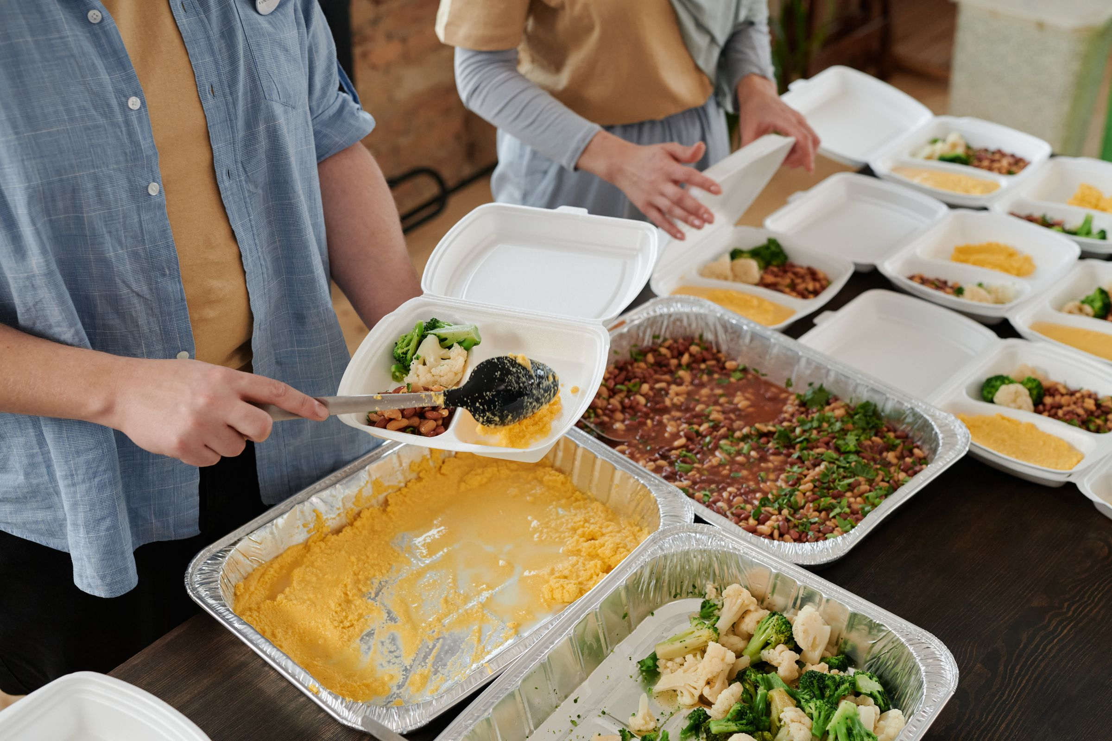

Photo Guidelines
Show collaboration, making, listening and testing. Prefer natural light, useful context and people actively shaping the work.
Choose and prepare
Collaboration
Hands-on work
Choose an unused library image and record its placement. Confirm its license and intended use. For organization photos, verify permissions and captions. Preserve skin tones and context.
Listening
Making
Use stock honestly
Use licensed stock to illustrate themes. Never describe these people as our participants or imply their endorsement. Add useful alt text and retain the source record.
Community action
Shared ideas
30 licensed photos. Each content placement uses a different image. Full photographer credits and licenses are in the photo library and slide notes.
Photo library, source links & placement register
MAXIMIZING POTENTIAL / BRAND GUIDELINES
23
Notes:
Structure and page topic adapted from West Valley College Brand Guidelines, page 23: https://www.westvalley.edu/offices/marketing/_files/pdf/wvc-brand-guidelines.pdf. Maximizing Potential visual identity: current BRAND.md and existing logo kit. Original MP wording; strategy pages 4–7 are proposed. Reusable source artwork is in the supplied asset pack. Stock photo: Monstera Production / Pexels. https://www.pexels.com/photo/diverse-students-discussing-project-at-table-6238033/ License: https://www.pexels.com/license/. Illustrative stock, not a Maximizing Potential event.
Stock photo: cottonbro studio / Pexels. https://www.pexels.com/photo/a-person-doing-woodwork-7482640/ License: https://www.pexels.com/license/. Illustrative stock, not a Maximizing Potential event.
Stock photo: Kampus Production / Pexels. https://www.pexels.com/photo/a-man-teaching-elderlies-to-use-a-laptop-7983549/ License: https://www.pexels.com/license/. Illustrative stock, not a Maximizing Potential event.
Stock photo: Ron Lach / Pexels. https://www.pexels.com/photo/architect-working-with-architectural-model-9618455/ License: https://www.pexels.com/license/. Illustrative stock, not a Maximizing Potential event.
Stock photo: Julia M Cameron / Pexels. https://www.pexels.com/photo/people-preparing-food-packs-6995247/ License: https://www.pexels.com/license/. Illustrative stock, not a Maximizing Potential event.
Stock photo: cottonbro studio / Pexels. https://www.pexels.com/photo/people-in-a-meeting-sharing-ideas-7430325/ License: https://www.pexels.com/license/. Illustrative stock, not a Maximizing Potential event.

Slide 24
Brand Guidelines
Accessibility
Make accessibility part of writing, design and production. People should be able to find, understand and use the final format they receive.
Layout and typography
Color contrast
Media and document access
07
MAXIMIZING POTENTIAL / BRAND GUIDELINES
24
Notes:
Structure and page topic adapted from West Valley College Brand Guidelines, page 24: https://www.westvalley.edu/offices/marketing/_files/pdf/wvc-brand-guidelines.pdf. Maximizing Potential visual identity: current BRAND.md and existing logo kit. Original MP wording; strategy pages 4–7 are proposed. Reusable source artwork is in the supplied asset pack.

Slide 25
Accessibility Guidelines
Use WCAG 2.2 AA as the digital design target. These practices do not by themselves certify ADA or WCAG compliance.
Layout & typography
NORMAL TEXT · 4.5:1 OR GREATER
Use clear heading order and logical reading sequence. Keep information selectable. Start print body copy at 11–12 pt and web body at 16 px, then test readability.
Aa Bb
Aa Bb
Aa Bb
Navy / white
Navy / ivory
Navy / gold
17.84:1
16.11:1
9.59:1
LARGE TEXT ONLY · 3:1 OR GREATER
Color & media
Aa Bb
Aa Bb
Normal text needs 4.5:1 contrast; large text needs 3:1 (18 pt regular or 14 pt bold). Pair color with labels. Meaningful interface cues and graphics generally need 3:1.
Antique gold / white
Deep gold / chevron
3.21:1
3.40:1
DO NOT USE FOR TEXT · BELOW 3:1
Add alt text and captions. Check keyboard access, document tags and reading order in the final format.
Aa Bb
Aa Bb
Antique gold / ivory
Chevron gold / white
2.90:1
1.86:1
W3C: Contrast minimum · Non-text contrast · Use of color
MAXIMIZING POTENTIAL / BRAND GUIDELINES
25
Notes:
Structure and page topic adapted from West Valley College Brand Guidelines, page 25: https://www.westvalley.edu/offices/marketing/_files/pdf/wvc-brand-guidelines.pdf. Maximizing Potential visual identity: current BRAND.md and existing logo kit. Original MP wording; strategy pages 4–7 are proposed. Reusable source artwork is in the supplied asset pack. Contrast sources: https://www.w3.org/WAI/WCAG22/Understanding/contrast-minimum.html ; https://www.w3.org/WAI/WCAG22/Understanding/non-text-contrast.html ; https://www.w3.org/WAI/WCAG22/Understanding/use-of-color.html . Ratios calculated from solid sRGB values; use unrounded ratios for thresholds. Test gradients, photos and final output separately.

Slide 26
Brand Guidelines
Content Guidelines
Our writing helps people understand the purpose, the people involved and the next step. Be warm about possibility and exact about commitments, availability and results.
Our voice
Messaging principles
Examples
08
MAXIMIZING POTENTIAL / BRAND GUIDELINES
26
Notes:
Structure and page topic adapted from West Valley College Brand Guidelines, page 26: https://www.westvalley.edu/offices/marketing/_files/pdf/wvc-brand-guidelines.pdf. Maximizing Potential visual identity: current BRAND.md and existing logo kit. Original MP wording; strategy pages 4–7 are proposed. Reusable source artwork is in the supplied asset pack.

Slide 27



Our Voice
Write as a thoughtful person explaining useful work to another person. Be encouraging without pressure, specific without jargon and honest about the stage of the work.
Messaging principles
Put people and purpose first.
Name the concrete support or action.
Separate plans, commitments and results.
Use plain language and a clear next step.
Recognize others accurately.
EXAMPLE · PROGRAM STATUS
“Broader funding and incubation programs are in development. Funding applications are not open.”
Reconfirm availability before publishing. Describe what support provides before claiming what it changes.
MAXIMIZING POTENTIAL / BRAND GUIDELINES
27
Notes:
Structure and page topic adapted from West Valley College Brand Guidelines, page 27: https://www.westvalley.edu/offices/marketing/_files/pdf/wvc-brand-guidelines.pdf. Maximizing Potential visual identity: current BRAND.md and existing logo kit. Original MP wording; strategy pages 4–7 are proposed. Reusable source artwork is in the supplied asset pack. Stock photo: Thirdman / Pexels. https://www.pexels.com/photo/women-standing-beside-the-whiteboard-with-papers-8485866/ License: https://www.pexels.com/license/. Illustrative stock, not a Maximizing Potential event.
Stock photo: Pavel Danilyuk / Pexels. https://www.pexels.com/photo/scientists-testing-a-device-8439009/ License: https://www.pexels.com/license/. Illustrative stock, not a Maximizing Potential event.
Stock photo: Monstera Production / Pexels. https://www.pexels.com/photo/colleagues-collaborating-on-a-work-9433170/ License: https://www.pexels.com/license/. Illustrative stock, not a Maximizing Potential event.

Slide 28
Brand Guidelines
Applications
Use the same identity across the materials people meet every day. Start from the supplied templates, replace each placeholder and check the final content at its intended size.
Email signature and letterhead
Digital ads and presentations
Flags and keychains
09
MAXIMIZING POTENTIAL / BRAND GUIDELINES
28
Notes:
Structure and page topic adapted from West Valley College Brand Guidelines, page 28: https://www.westvalley.edu/offices/marketing/_files/pdf/wvc-brand-guidelines.pdf. Maximizing Potential visual identity: current BRAND.md and existing logo kit. Original MP wording; strategy pages 4–7 are proposed. Reusable source artwork is in the supplied asset pack.

Slide 29

Everyday Correspondence
[Full name]
[Role] | Maximizing Potential
maximizing.potential.admin@gmail.com
(408) 813-9857
home.maximizingpotential.workers.dev
Email signature
Letterhead
Live HTML text and links; replace name and role.
US Letter · editable Word · matching PDF
MAXIMIZING POTENTIAL / BRAND GUIDELINES
29
Notes:
Structure and page topic adapted from West Valley College Brand Guidelines, page 29: https://www.westvalley.edu/offices/marketing/_files/pdf/wvc-brand-guidelines.pdf. Maximizing Potential visual identity: current BRAND.md and existing logo kit. Original MP wording; strategy pages 4–7 are proposed. Reusable source artwork is in the supplied asset pack.

Slide 30

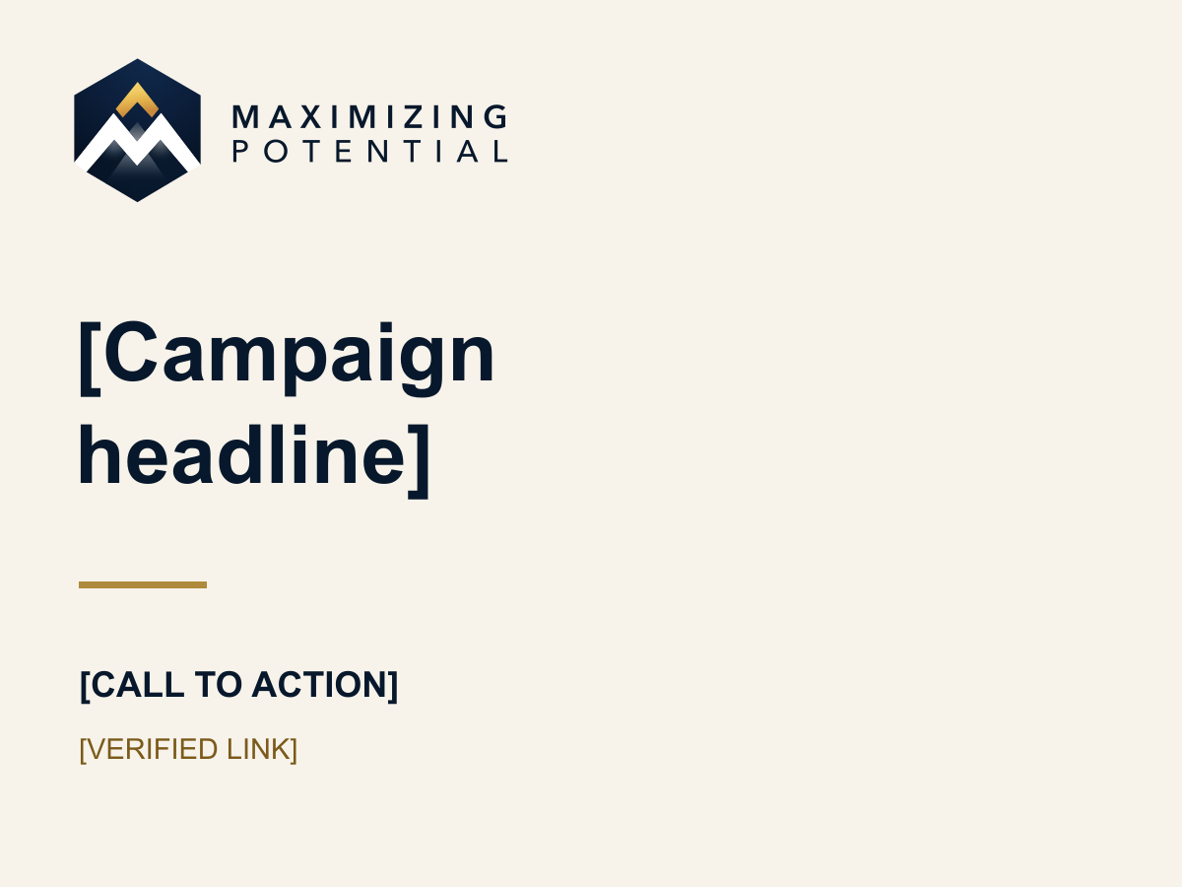

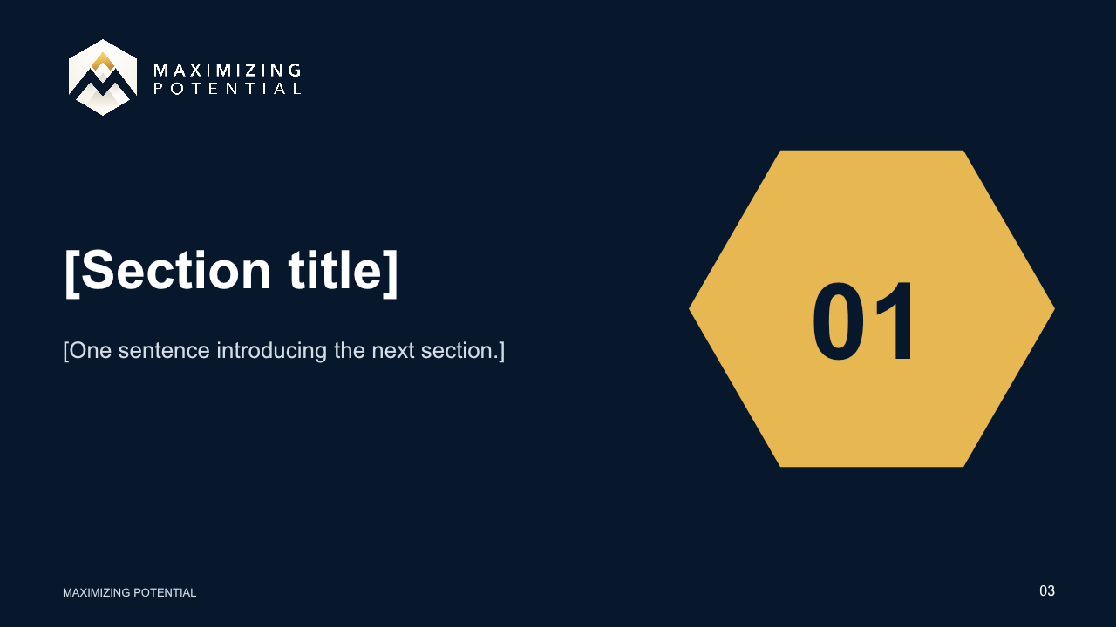
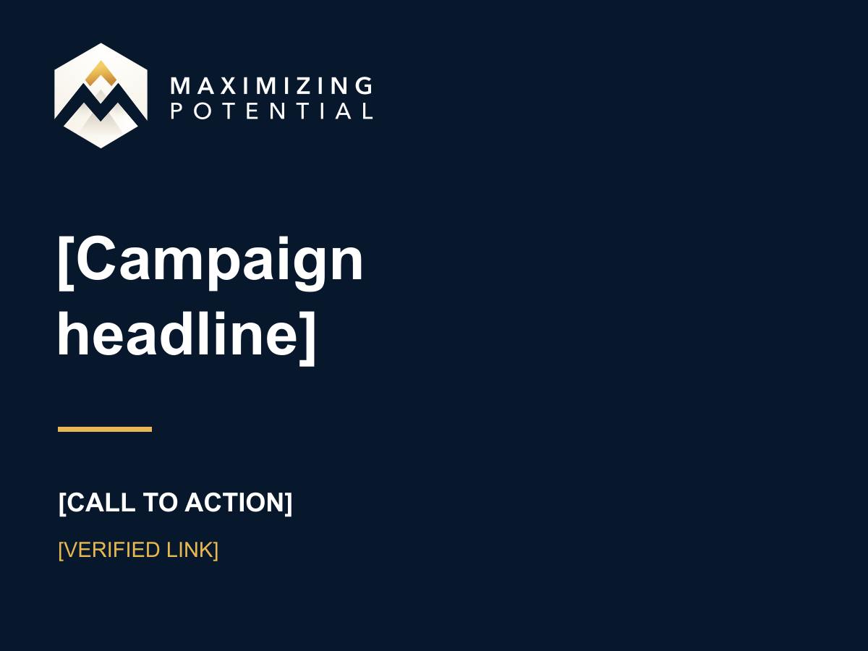
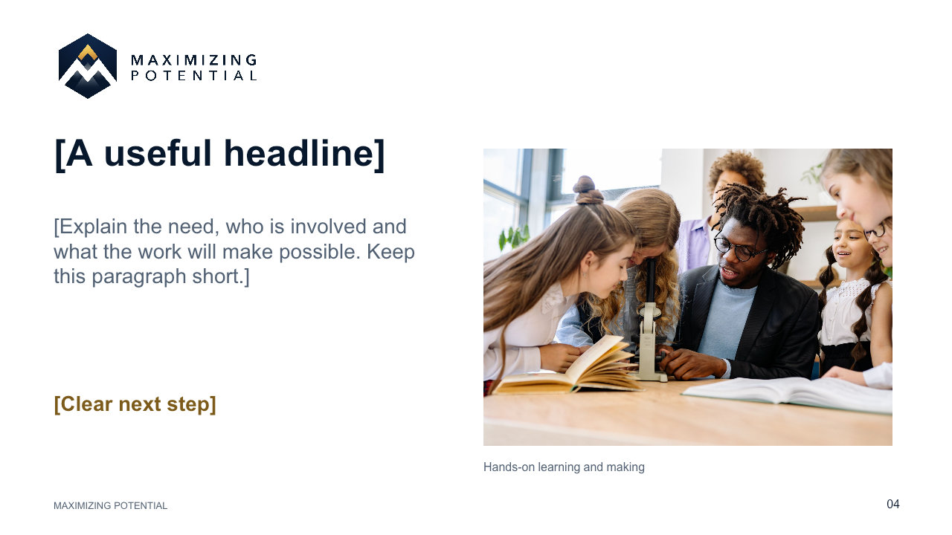
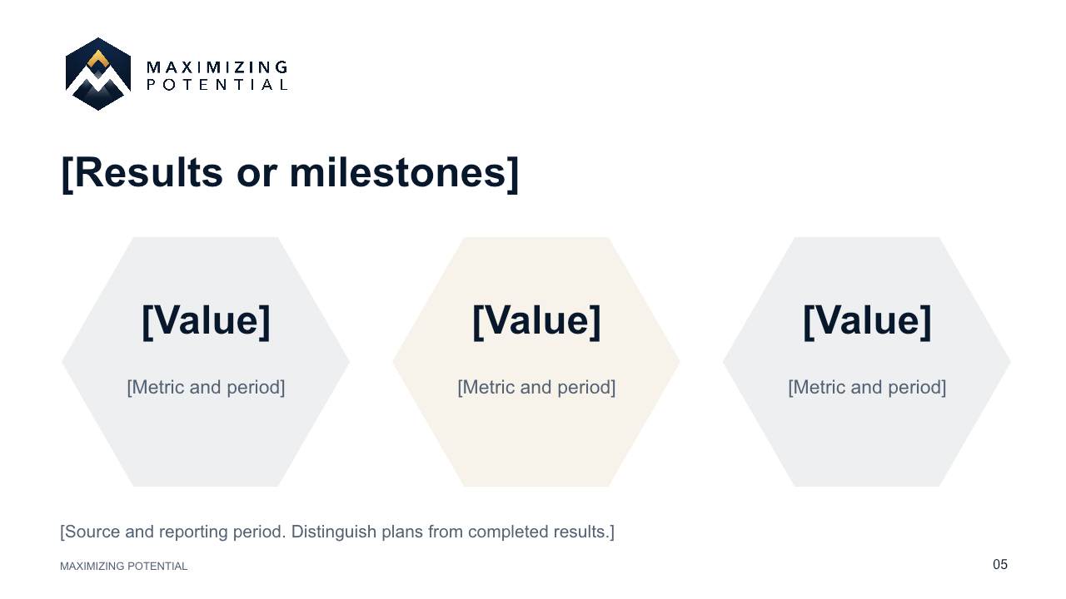
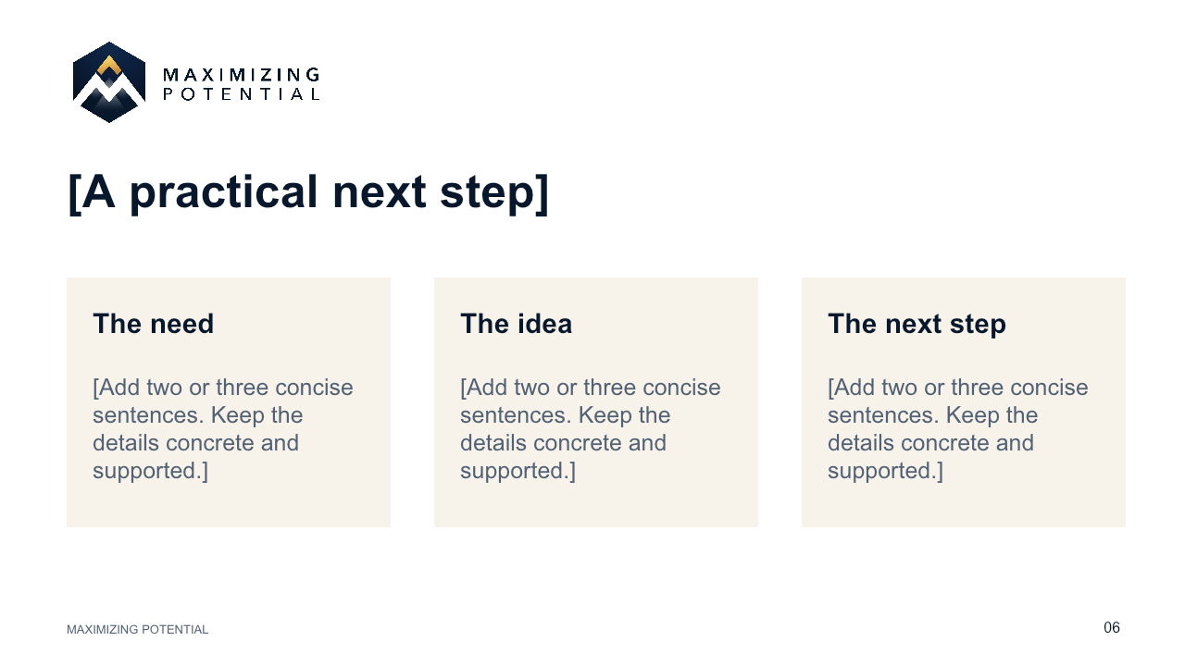

Presentation template
Digital ads
MAXIMIZING POTENTIAL / BRAND GUIDELINES
30
Notes:
Structure and page topic adapted from West Valley College Brand Guidelines, page 30: https://www.westvalley.edu/offices/marketing/_files/pdf/wvc-brand-guidelines.pdf. Maximizing Potential visual identity: current BRAND.md and existing logo kit. Original MP wording; strategy pages 4–7 are proposed. Reusable source artwork is in the supplied asset pack.

Slide 31





Flags & Keychains
Use the simplest arrangement that remains legible at the intended size. These are artwork concepts; the supplier must confirm its production template and proof.
Flagpole banner
Keychain · front / back
24 × 60 in concepts
2 in diameter concepts
Feather flag
MAXIMIZING POTENTIAL / BRAND GUIDELINES
31
Notes:
Structure and page topic adapted from West Valley College Brand Guidelines, page 31: https://www.westvalley.edu/offices/marketing/_files/pdf/wvc-brand-guidelines.pdf. Maximizing Potential visual identity: current BRAND.md and existing logo kit. Original MP wording; strategy pages 4–7 are proposed. Reusable source artwork is in the supplied asset pack.

Slide 32



We’re here
to help.
Start with the current brand kit. For a new layout or partner lockup, send your draft with the audience, final size, channel and deadline.
maximizing.potential.admin@gmail.com
(408) 813-9857
home.maximizingpotential.workers.dev
Notes:
Structure and page topic adapted from West Valley College Brand Guidelines, page 32: https://www.westvalley.edu/offices/marketing/_files/pdf/wvc-brand-guidelines.pdf. Maximizing Potential visual identity: current BRAND.md and existing logo kit. Original MP wording; strategy pages 4–7 are proposed. Reusable source artwork is in the supplied asset pack. Stock photo: George Pak / Pexels. https://www.pexels.com/photo/three-young-people-studying-together-outdoors-with-laptops-7972948/ License: https://www.pexels.com/license/. Illustrative stock, not a Maximizing Potential event.
Stock photo: Thirdman / Pexels. https://www.pexels.com/photo/volunteer-man-planting-tree-in-the-ground-7656745/ License: https://www.pexels.com/license/. Illustrative stock, not a Maximizing Potential event.
Stock photo: Vanessa Loring / Pexels. https://www.pexels.com/photo/young-students-doing-robotics-together-7869041/ License: https://www.pexels.com/license/. Illustrative stock, not a Maximizing Potential event.

